Slide 1

Revolutionizing Construction Labor Matching
Welcome to the Yaya Labor Matching System. We connect contractors with verified, skilled construction workers. Our system uses cutting-edge AI and blockchain technology.
BY GROUP 14

Slide 2
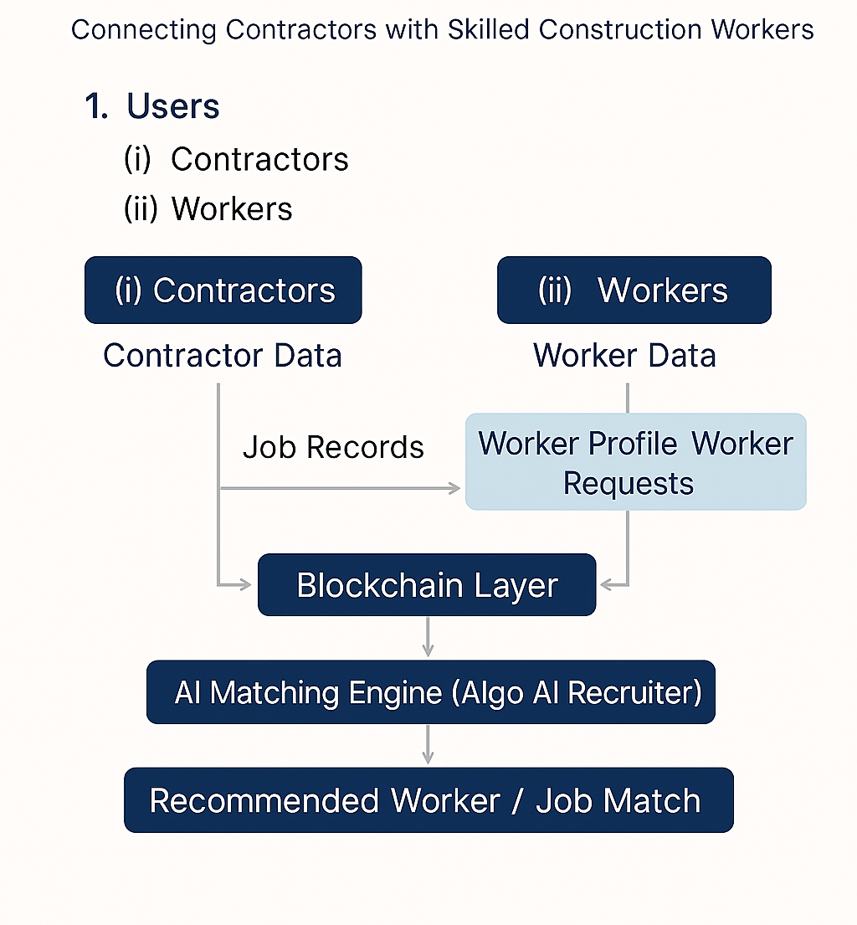
The Yaya Labor Matching System: An Overview
This flowchart illustrates the end-to-end process. It shows how contractors and workers interact. We focus on trusted labor matching.

Slide 3

Seamless User Registration and Data Collection
Contractor Onboarding
Contractors create profiles. They submit company details. They list job requirements.
Worker Profile Setup
Workers register on the platform. They provide personal and professional data. This includes certifications and experience.

Slide 4
Comprehensive Activity and Record Capture
Contractor Job Creation
Worker Performance Tracking
Contractors define new jobs. They specify type, duration, and location. Project details ensure precise matching.
Workers accumulate profiles. They receive reviews after each job. This builds a reliable work history.

Slide 5

Ensuring Trust with the Blockchain Layer
Tamper-Proof Ledger
All job records are stored securely. Worker reviews are also immutable. This prevents any data manipulation.
Guaranteed Data Integrity
Blockchain ensures authenticity. It builds trust and transparency. No fake histories or manipulated reviews are possible.

Slide 6




Intelligent AI Matching Engine: Yaya AI Recruiters
Skill Analysis
AI evaluates worker skills. It matches them to job requirements. This ensures competency for tasks.
Review Sentiment
The AI analyzes review sentiment. It identifies top-performing workers. Positive feedback is prioritized.
Location and Availability
It considers job location. Worker availability is also key. This optimizes logistics and scheduling.

Slide 7
Optimized Outputs: Smart Recommendations
Contractor Recommendations
Worker Job Notifications
Contractors receive top worker matches. These are tailored to job specifications. Best-fit candidates are prioritized.
Workers get instant job alerts. They receive opportunities near them. Relevant matches improve engagement.

Slide 8




Future Enhancements and Next Steps
Automated Payments
Smart contracts will streamline payments. Job confirmations will be instant. This improves efficiency and trust.
Reputation Scoring
A new model will boost high performers. Workers earn higher scores. This incentivizes quality work.
Expanding Partnerships
We aim to partner with industry leaders. This will expand our reach. We will serve more contractors and workers.

